Slide 1
CPMHA MANAGERS & COACHES MEETING
5 OCT 2025
References
  CPMHA Constitution V11.2
  CPMHA Team Handbook V1.1
  HEO By-Laws and Policies

Slide 2
OUTLINE
Introductions
Important dates
Roles & Responsibilities
  Manager
  Coaches
  Trainer
  Treasurer
  Equipment Manager
Communication Model
Rosters
Travel Permits
SportzHeads & Socials
LCMHL & CPMHA Website
Equipment
Tournaments
TTM
Ice Release
Team Photos

Slide 3
OUTLINE
Dressing room policy
On ice Helpers
References
Development
  End of Managers meeting
Qualifications
Training
Pathways
Shared Folder (Head Coach Only)
  Conditioning
  Affiliates
  One Ice Helpers
  Roster Build (Managers Only)
Pathways
Coach Mentor
Referee in Chief
Risk & Safety
  Hearings
  Discipline Framework

Slide 4


Slide 5
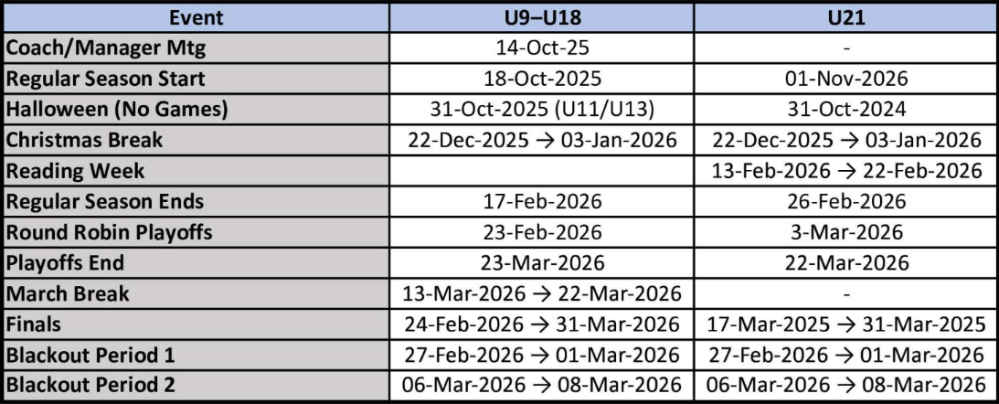
Important dates

Slide 6
VSCs and HEO Screening process
All volunteers need a completed VSC and screening form by the 31 Oct of the current season.
VSCs are to be uploaded in your spordal account under documents, once this is complete the registrar will get an email to approve the VSC.
Vulnerable Sector Check | Hockey Eastern Ontario
  Screening application will automatically update in HCR (24-48 hrs)

Slide 7
Manager - Roles and Responsibilities
Attend the LCMHL Mandatory Coaches and Managers Meeting (October 14).
The Team Manager is responsible for the administration and organization of the team, working closely with the Head Coach and the level Convenor. It is CPMHA policy that the Head Coach and Manager cannot be members of the same family.
The Team Manager’s key responsibilities include:
Coordinating a meeting at the beginning of the season to welcome parents and encourage input and participation; coordinating additional parent meetings in a timely fashion as necessary to discuss issues as they arise
Keeping an up-to-date official team roster, including all players and coaching staff, which should be maintained in a team binder, rosters can be obtained from the level Convenor.

Slide 8
Manager - Roles and Responsibilities
Uploading team roster into CPMHA and LCMHL website.
Informing parents of any required courses or obligations related to CPMHA
Review the Code of Conduct for Parents/Guardians at the team meeting.
  Note: The Code of Conduct was digitally signed at registration, and the registering member is responsible for ensuring all family members are aware of the policy.
With parent permission, compile and distribute a contact list with names, email addresses, and phone numbers of all players and coaching staff to the team members and parents.
Supporting the Team Treasurer to manage team finances transparently and responsibly.
Arranging for scorekeepers and timekeepers for each home game, ensuring they are trained in the use of the equipment and familiar with the relevant regulations.

Slide 9
Manager - Roles and Responsibilities
Completing the game sheet with the team list for each game, obtaining the required signatures, and inputting game results into the LCMHL SportsHeadz system for all home games.
Entering suspensions and affiliates into TTM.
Team photos (Organized by Ice Scheduler).
Coordinating with the Head Coach to make necessary arrangements for exhibition games, tournaments, and other team activities.
Submit Tournaments form via LCMHL after receiving permission from League Statistician
Ice release (discuss with H/Coach who will coordinates this aspect)
Submitting Rosters and Travel Permits.

Slide 10
Head Coach Roles and Responsibilities
Attend the LCMHL Mandatory Coaches and Managers Meeting (October 14).
Be organized, consistent, fair, and available to players, staff, and parents.
Plan and conduct well-organized, appropriate practices that contribute to player development.
Ensure a certified Trainer is present on the bench at all games.
Adhere to all rules and regulations set by hockey bodies, including the "Two-Deep Rule," anti-bullying, harassment, and hazing policies.
Apply discipline fairly and promptly when needed. CPMHA Handbook progressive discipline.
Address potential issues early, seeking assistance from CPMHA when necessary.
Report ongoing discipline problems to the level Convenor.
Attend any disciplinary hearings or meetings as required.

Slide 11
Head Coach Roles and Responsibilities
Ensure that all team staff obtain the required certifications and qualifications by CPMHA deadlines.
Attend all League and Association Coaches’ meetings.
Submit a list of all team officials to the Convenor.
Select tournaments, keeping team finances and input from parents in mind.
Manage unused ice time, including trading or giving it away when necessary. Ice release.
Support and adhere to decisions made by the CPMHA Executive and Association policies.
Prepare and confirm player affiliations as needed.
Communicate regularly with other coaches, managers, and the level Convenor.

Slide 12
Assistant Coach Roles and Responsibilities
Assistant Coaches are a crucial support system for the Head Coach, playing an essential role in player development and the overall success of the team.
Assist with drills during practices as directed by the Head Coach.
Attend all Coaches’ meetings and support the expectations set by the Head Coach for players.
All Assistant Coaches must hold the necessary certifications and qualifications as the Head Coach.

Slide 13
Trainer Roles and Responsibilities
Maintain up-to-date certification(s) required for the role
Ensure a fully stocked first aid kit is available during all games and practices
Maintain the completed medical information sheets for each of the players on the team, including any allergies or conditions (e.g., asthma) the player has and any treatments required
Ensure that the required accident/injury reports are completed and to certify that injured players only return to play with the appropriate signed medical authorization
Monitor physical conditioning to ensure it is consistent with the level of play and ensure that players are physically prepared to function at their age level or the level of play

Slide 14
Trainer Roles and Responsibilities
Ensure that players only participate in on-ice activities with CSA-approved equipment that is safe and in good condition, and in "full" equipment in accordance with all HEO Minor and Hockey Canada regulations
Identify and report potentially dangerous situations that may lead to injury (such as. ice surface, boards, dressing rooms)
Remain with an injured player and ensure they receive the proper medical attention in a timely manner
Identify and report potentially dangerous situations that may lead to injury (such as. ice surface, boards, dressing rooms)
Remain with an injured player and ensure they receive the proper medical attention in a timely manner
Ensure that players only participate in on-ice activities with CSA-approved equipment that is safe and in good condition, and in "full" equipment in accordance with all HEO Minor and Hockey Canada regulations

Slide 15
Treasurer Roles and Responsibilities
Each team must appoint one individual as Team Treasurer. This person cannot be, nor be from the same family as, the Team Manager or Head Coach.
The Team Treasurer is responsible for creating and managing the team budget, which should be determined in collaboration with the Head Coach and Manager.
Team fees collected from each family must be deposited into the team account. Team fees must not exceed $200 per player. As tournament costs continue to rise, smaller teams may struggle to cover these expenses. If the entire team reaches a unanimous and anonymous agreement, they may collect additional funds as needed.

Slide 16
Treasurer Roles and Responsibilities
Additionally, teams are encouraged to participate in fundraising activities or seek sponsorships to help offset tournament costs.
All major expenses must be approved by team majority vote.
All teams must open one team bank account, for which two signatories are required.
The signatories cannot be from the same family.
The account must be in the name of the team, not an individual.
A letter of request to open a team account will be provided by the CPMHA Treasurer or VP Admin.

Slide 17
Team Equipment Manager
Roles and Responsibilities
Each team must assign one parent or guardian as Team Equipment Manager. The Team Equipment Manager is responsible for working with the CPMHA Equipment Manager to obtain and maintain inventory and condition of all jerseys and additional equipment supplied by the CPMHA (including goalie equipment).
While not in use, all game jerseys will be kept by the Team Equipment Manager, who will ensure the proper set of jerseys is available at least prior to the start of each game. The Team Equipment Manager is responsible for washing jerseys as required and for collecting and returning all CPMHA equipment at the end of the season.

Slide 18
COMMUNICATION MODEL
All executive emails can be found at Contact Us (Carleton Place Minor Hockey Association) (cpmha.ca)
Communication model Communication Model (Carleton Place Minor Hockey Association) (cpmha.ca)
  Manager/Head Coach
  Convenor
    To appropriate authority
  Incident reporting form.
Coaches can contact Risk & Safety/RIC but cc Convenor, so they are aware.
Do not contact the LCMHL, District 4, HEO, or Hockey Canada without first having attempted to resolve via the CPMHA communications model.

Slide 19
COMMUNICATION MODEL
Complaints
  Write up complaint the night of the incident but wait 24 hours before sending.

Slide 20
Rosters
Submit Initial Team roster by 15 Oct.
Convenors and Managers must build the CPMHA roster. Once Managers have been identified they will be given access to the CPMHA Roster build file. Any delays in completing this will result in delays of obtaining an official roster.
Submit Final Team roster by 15 Nov
Approved Rosters are typically required for a team to participate in a tournament. If required before the deadline of submission this must be communicated to the convenor who will contact the registrar.

Slide 21
Travel Permits
Travel permits are required for all tournaments, and exhibition games from U9-U18. This includes local tournaments and exhibition games within D4. This allows HEO to monitor and confirm that the proper development pathways are being followed.
Travel Permit must be completed in Spordel by the manger well in advance of the tournament and exhibition date, as signatures from the CPMHA President and D4 Chair must be returned before you can confirm your spot in the tournament.
Managers can find approved Travel Permits in their Spordal account. If the game for which the travel permit is canceled, you must notify the Convenor and Registrar to have it cancelled. Spordel - Manage/Travel Permit/Add.

Slide 22
Travel Permits
Details to complete travel permits can by found on the CPMHA website. Completing_a_Travel_Permit_in_Spordal.pdf
Operations/How-To’s/Manager

Slide 23
SportzHeadz & Social Media
Mobile app for team staff to communicate with parents and players
Secure access: Coaches/Managers approve team members on app
Website login for Head Coach and Manager
How-to guides available under Operations > How-To’s on the website
For Instagram and Facebook posts, email: socials@cpmha.ca
Posts are managed by the social media team

Slide 24
LCMHL & CPMHA Website
LCMHL website
  League Statistician will send an email to all managers, requesting contact info to create accounts.
  Managers log every home game into LCMHL website. More info from League.
CPMHA website
  Players on website separate from mobile app.
  No sync between mobile app and LCMHL website

Slide 25
EQUIPMENT
Team Equipment Manager
  Every team must have 1. Responsible for bringing jerseys to games. Players do not keep them.
  Jerseys home and away sets. ($500 deposit cheque required post dated to March 31 2026)
  First Aid Kit (If required)
Goalie Equipment
  U7
  U9
Socks – Available at Valley Edge
Practice Pinnies – Upon request, limited stock
Deck Box – Location to be determined.
Reach out to me anytime with any issues or questions

Slide 26
Tournaments
Looking to standardize CPMHA tournaments, which would allow members at least 4 years of Home tournaments. Will be looking to add more tournaments in 2027.
  U13 A – 3-4 Jan 26
  U13 B – 31 Jan – 1Feb 26
  U13 C – N/A
  U15 A – 18-19 Oct 25
  U15 B – 15-16 Nov 25

Slide 27

TTM is where affiliations and suspensions are recorded.
Coach and manager will get an account.
Information about obtaining a TTM account is available from LCMHL.ca Obtaining a TTM Account
Easy to use once logged in and rosters are in properly.
Help files available on CPMHA.
Suspensions must be uploaded within 24 Hours, or the coach will be suspended
You will require a copy of the game sheet to upload when reporting the infraction

Slide 28
Ice Scheduler
Ice release
  Ice must be released within 72 hrs of practice time or team will have to pay.
    Ice Release form – CPMHA Website
  To change games, you must follow the instructions provided by LCMHL and copy the Ice scheduler.
    LCMHL site - Game Switches and Reschedules (Lanark Carleton Minor Hockey League)
  You must submit a form for every tournament so the time can be blocked from the teams calendar.
    Tournaments date form – CPMHA Website
  Once we receive the game schedule from LCMHL the calendar will be populated up until Dec.

Slide 29
Team Photos
Portraits Now Sports
  Organized by the ice Scheduler.
  Will not be on Ice.
  Will be in the Jan timeframe and will be completed over a 2-day period.

Slide 30
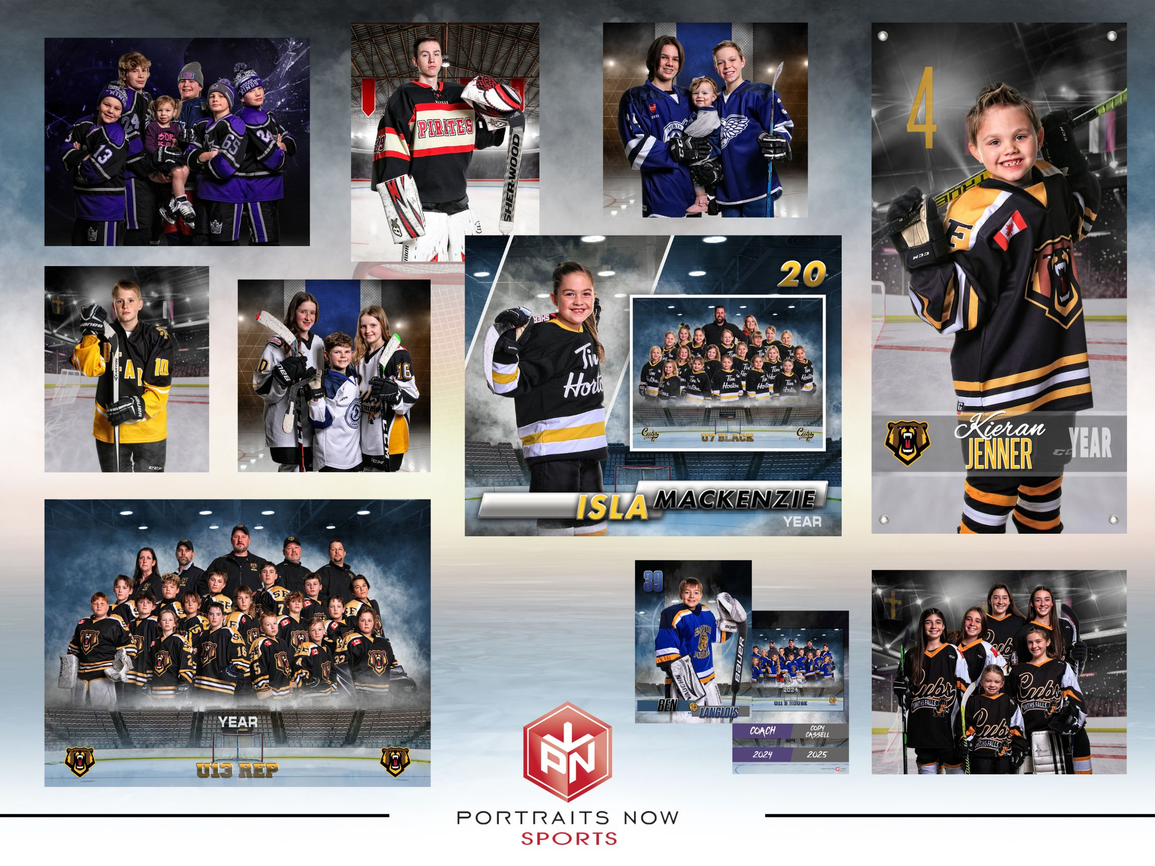
Team Photos
Portraits Now Sports
  Organized by the ice Scheduler
  Will not be on Ice
  Will be in the Jan timeframe and will be completed over a 2-day period.

Slide 31
DRESSING ROOM POLICY
CPMHA will diligently protect all participants from all forms of Maltreatment.
Supervising personnel must be members of the team staff or adults who have completed... the Respect in Sport for Activity Leaders course, the Gender Identity and Expression Course, and have submitted their record checks (VSC/CRC).
Rule of Two – A lone member should never be in the dressing room with players at any time, especially when players are showering or changing: two adults must be present together.
Phones/Cameras – Are not to be out in the dressing rooms.

Slide 32
ON ICE HELPERS
Individuals that volunteer within an association must be either; a “registered” member of a Minor Hockey Association, or a Junior Hockey League, or an on-ice official. This ensures that the insurance coverage has been secured.
On-Ice Helper” is limited to those under age 20 who wish to give back to the game, perhaps become involved in coaching or obtain high school volunteer credit hours.
Individuals that help must be at minimum; one age division higher than the team which they are helping with.
Individuals that help must wear as a minimum a helmet, and facial protection, neck guard as well as hockey gloves and skates. HEO requires full equipment to be worn for any on-ice helper under the age of 16. (this will be discussed at the next board meeting and may change)
Coaches will have access to an excel spreadsheet with available on ice helpers.

Slide 33
References
Constitution
  Version 11.2 – April 2025
  Posted to CPMHA website
CPMHA Handbook
  Mandatory reading for all volunteers and encourage parents to read it as well.
  Version 11.1 – Aug 2025
  Updated responsibilities
  Updated procedures
  Added progressive discipline framework for coaches (briefed to coaches by Risk & Safety)

Slide 34
DEVELOPMENT
  Player Development – Hockey University – Sami Holmes
  Coach Development
    U7 – will concentrate on appropriate drills for U7.
  Player Development
    U9,U11,U13,U15 – 4 sessions shared ice
    U18 – 3 sessions shared ice
  Goalie development – COBSY’S GOALTENDING
    U9,U11 – 9 sessions
    U13,U15,U18 – 9 sessions
Notes:
Sami to brief the development if available.

Slide 35
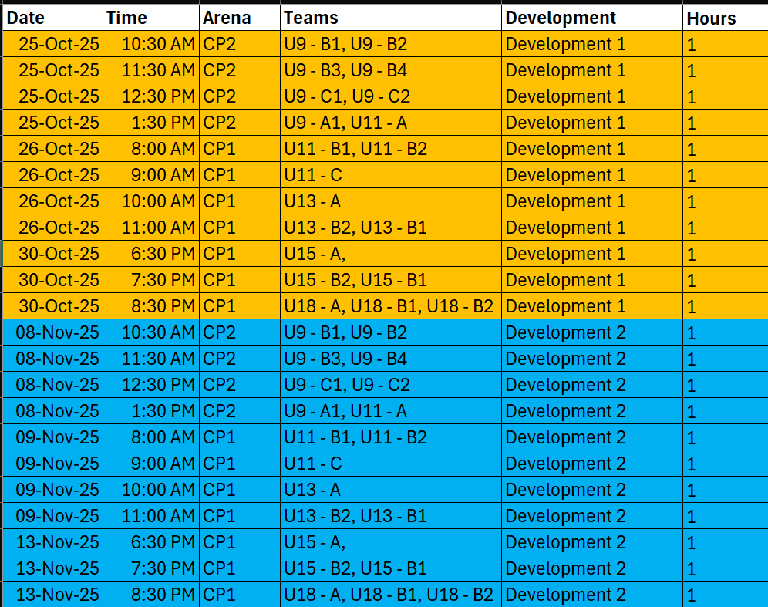
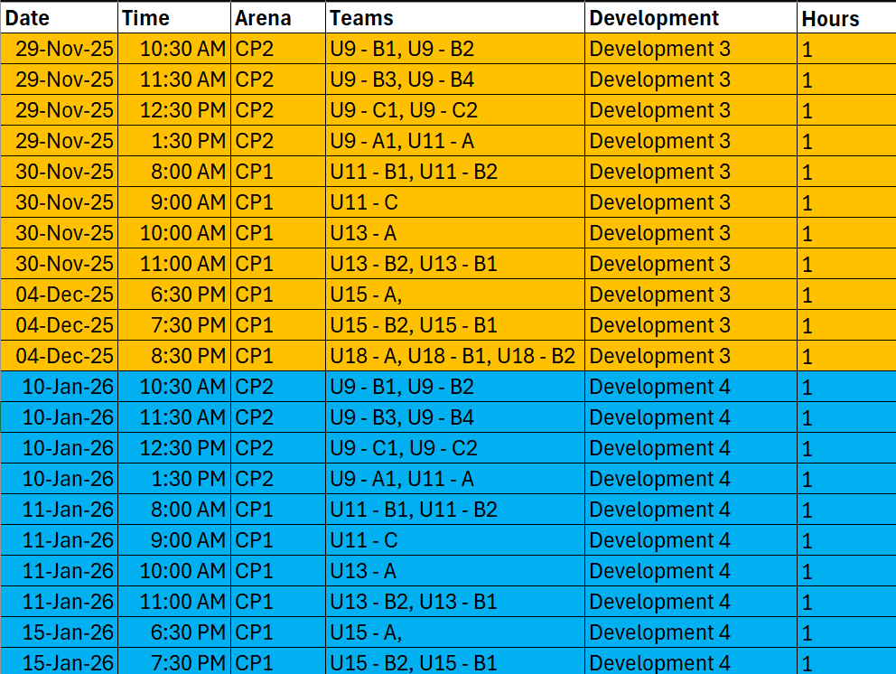
DEVELOPMENT

Slide 36
DEVELOPMENT
  Player Development
    If you need to change dates due to a tournament, please try and swap with another team.
    We want your feedback.
  Goalie development – COBSY’S GOALTENDING
    Dates are being finalized – 1st development was today the 5 Oct 25.

Slide 37
Questions – End of Managers brief

Slide 38
QUALIFICATIONS
U7
U9
U11
Coach 1 (1 day in class course)
Hockey Canada Coach 1 (online clinic)
Hockey Canada Coach 1 - U7 (online module specifically for coaches coaching U7)
Respect in Sport for Activity Leaders
Gender Identity Online Training
Coach 1 (1 day in class course)
Hockey Canada Coach 1 (online clinic)
Hockey Canada Coach 1 - U9 (online module specifically for coaches coaching U9)
Respect in Sport for Activity Leaders
Gender Identity Online Training
Coach 2 (1 day in class course)
Hockey Canada Coach 2 (online clinic)
Hockey Canada Coach 2 - U11 (online module specifically for coaches coaching U11)
Respect in Sport for Activity Leaders
Gender Identity Online Training
These qualification apply to both Head and Assistant coaches

Slide 39
QUALIFICATIONS
U13
U15
U18
Coach 2 (1 day in class course)
Hockey Canada Coach 2 (online clinic)
Hockey Canada Coach 2 - U13 (online module specifically for coaches coaching U13)
Respect in Sport for Activity Leaders
Gender Identity Online Training
Coach 2 (1 day in class course)
Hockey Canada Coach 2 (online clinic)
Hockey Canada Coach 2 - U15/U18 (online module specifically for coaches coaching U15)
Respect in Sport for Activity Leaders
Gender Identity Online Training
Coach 2 (1 day in class course)
Hockey Canada Coach 2 (online clinic)
Hockey Canada Coach 2 - U15/U18 (online module specifically for coaches coaching U18)
Respect in Sport for Activity Leaders
Gender Identity Online Training
.
These qualification apply to both Head and Assistant coaches

Slide 40
QUALIFICATIONS
Required qualifications can be found at Certification / Qualification Requirements | Hockey Eastern Ontario

Slide 41
EQUIVALENCIES
U7/U9
  If you have legacy Coach 1 & 2 online you do not need to do HC Coach 1 online
  If you have legacy Coach 1 – Intro to coaching, you are not required to take any new courses.
U11/U13/U15/U18
  If you have legacy Coach 1 & 2 online you do not need to do HC Coach 2 online
  If you have legacy Coach 2 – Coach level, you are not required to take any new courses.

Slide 42
QUALIFICATIONS
Coaches
  All Bench and On-Ice Staff must have completed Respect in Sport (RIS)-Activity Leader or Speak-Out, Gender Identity and Expression Course, and be registered for the appropriate clinic before their First Regular season league game or on-ice activity (Initiation program) to remain on the team’s roster. All required courses must have been taken before November 30th of the current season.
Trainers
  Trainer Level 1 certification/recertification or Trainer Level 2 upgrades/renewals must be done no later than October 31st of the current season.

Slide 43
TRAINING
Need to have approval from level convenor to register for a course, form can be found at cpmha.ca
Invoice must be submitted to the treasurer with 14 days of course completion, along with proof of completion.

Slide 44
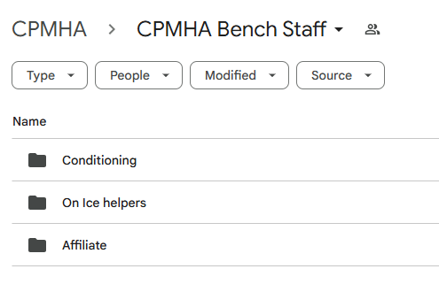
Shared Folder (Head Coaches)

Slide 45
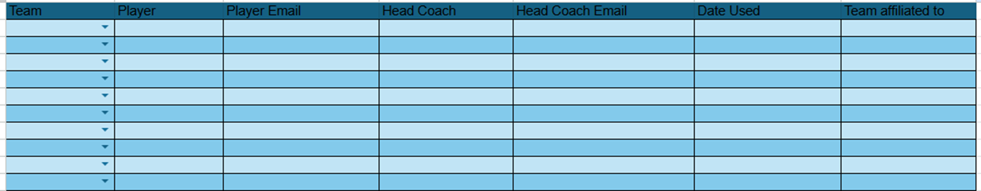
Affiliates
LCMHL uses the club system, no need to roster unless needed for a tournament.
Head coaches add player to the affiliate list, once they receive permission from player and guardian.
When coaches need an affiliate go to the list find a player, receive coach approval, and parent approval.

Slide 46
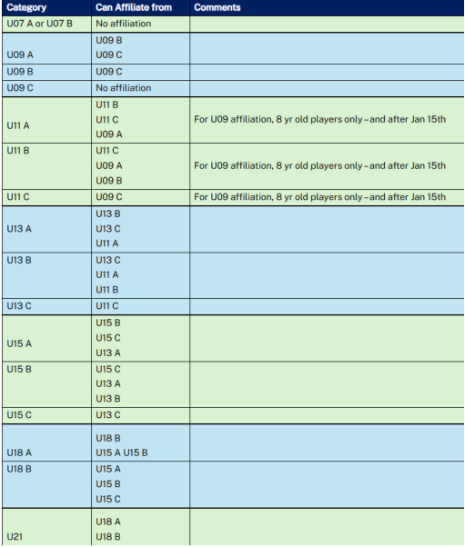

Slide 47
On Ice Helpers
Head Coach and Manager canvas your teams to see if anyone want to help at the lower levels.
Typically used for DEMOs and moving pucks, CPMHA will sign off on volunteer hours.
Head coaches or Managers add player to the on-ice helper list, once they receive permission from guardian.

Slide 48
Pathways
HEO 6.16.1 - U7 Player Pathway Policy
HEO 6.16.2 - U9 Player Pathway Policy
HEO 6.16.3 - U11 Player Pathway Policy
HEO 6.16.4 - U13 Player Pathway Policy
HEO 6.16.5 - U15 Player Pathway Policy
  Rules in general
  Practice breakdown - Practices should consist of small area games/station based/skill focussed drills. A minimum of 55% of practice sessions must be spent on skills and tactics. 45% of practice time can be used to focus on Team Play and Strategy.
Notes:
Tournaments are based on a 3 game tournament. U9 has 9 games under tournaments which means they can have 3 tournaments, regardless of the umber of games played at that tournament..

Slide 49
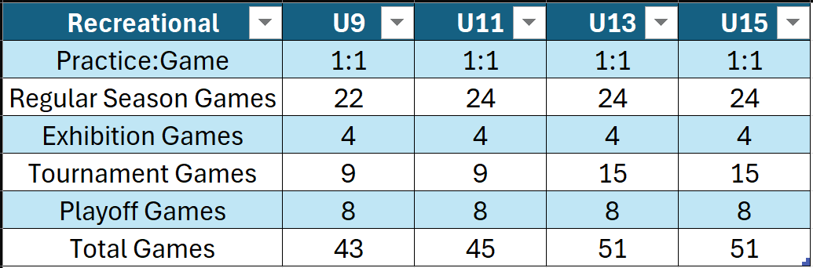
Pathways
Tournaments are based on a 3 game tournament. For example U9 has 9 games under tournaments which means they can have 3 tournaments, regardless of the number of games played at that tournament. Home tournaments do not count toward this total. Exhibition and Tournaments are tracked by the District using Travel permits.
Notes:
Tournaments are based on a 3 game tournament. U9 has 9 games under tournaments which means they can have 3 tournaments, regardless of the number of games played at that tournament..

Slide 50
COACH MENTOR
Intro email coming once convenors finalize lists
Includes: IHS login, practice plan templates, Pathways links, and more
I’m available for planning, systems, and age-appropriate strategy
I’m here to provide resources, examples, and help
Bring me concerns early; I’ll help troubleshoot

Slide 51
COACHING EXPECTATIONS
Practice Plans
Plan every practice (even a simple 3–5 drill plan)
Purposeful, age-appropriate, game-relevant
Maximizes limited ice; reduces downtime
Builds trust & consistency
Effective Practice Format: Principles
High tempo; keep players moving
Teach core skills: skating, passing, shooting
Add situational and decision-making reps
Rotate stations; small area games
Make practices fun; balance work and play

Slide 52
COACHING EXPECTATIONS
Practice Design: Tactics that Work
Break up the ice: 2–3 stations
Avoid long lines
SAGs to finish concepts
Incorporate fun (reward hard work)
Not 1985: we don’t bag skate kids to misery

Slide 53
ICE HOCKEY SYSTEMS (IHS)
What It Is?
Online library: drills, practice plans, systems, coach education
Works for new and veteran coaches
Video demos & animated diagrams
Why Use It?
Efficient: build plans in minutes
Skill growth: diverse drills for technical & tactical
Keep learning: current methods & strategies
Customizable: tune to team & level

Slide 54
ICE HOCKEY SYSTEMS (IHS)
How to Get Started
Explore drill libraries by skill/focus
Use/modify sample plans
Watch instructional videos
Mobile-friendly at the rink
Need Help? Email (coach.mentor@cpmha.ca)
IHS - Ice Hockey Systems (IHS Website)
Username: Carleton Place Kings
Password: cpmhakings

Slide 55
HOCKEY CANADA DRILL HUB
What It Is?
Online library: drills, practice plans, coach education
Works for new and veteran coaches
Video demos & animated diagrams
Why Use It?
Efficient: build plans in minutes
Skill growth: diverse drills for technical & tactical
Keep learning: current methods & strategies
Customizable: tune to team & level

Slide 56
Hockey Canada Instructional Stream Clinics
Hockey Canada offers Instructional Stream clinics, certified by the Coaching Association of Canada, that provide training and/or certification in a variety of technical and tactical areas.
These clinics are designed for coaches. They focus on developing the knowledge and skills required to teach age appropriate skills in accordance with Hockey Canada's LTPD model. Highly Recommended for all coaches.

Slide 57
SKATING CLINICS
The Skating Instructional Stream clinic provides coaches the tools and skills required to teach skating in a progressive manner, from skills to tactics, to players of all ages. | Skating Level 1 Stance and Balance Forward Stride Forward Crossovers Stops Backward Stride Backward Crossovers Turning, Transition, Pivots Quick Feet | Skating Level 2 Agility and Balance Coordination and Edge Control Forward Skating Backward Skating Turning, Crossovers Quickness and Transition
Register for clinics (skating, skills, checking, goaltending, defence, SAGs, etc)
HEO Clinics and Registration (Spordle Website)

Slide 58
COACHING RESOURCES
IHS - Ice Hockey Systems (IHS Website)
Username: Carleton Place Kings
Password: cpmhakings
Hockey Canada Drill Hub (HC Drill Hub Website)
U7 (Timbits) Practice Plans (U7 HC Website)
U9 Practice Plans (U9 HC Website)
HEO Clinics and Registration (Spordle Website)
Need Help?
Email (coach.mentor@cpmha.ca)

Slide 59
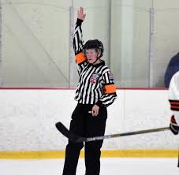
REFEREE IN CHIEF
CPMHA Officiating Program Goals
  Foster a respectful relationship between officials, coaches, parents, and fans
    All officials supervised at least 2x
    All first year officials properly mentored and supervised
    Development of all officials:
      New officials (HL sort out games & October 1)
      3 person officiating (November 26)
      September 16 MTK games for 2-3 year officials
  To standardize the methods and techniques with respect to rule interpretation and application within CPMHA Officiating Program
  Be a contributing participant to the betterment of hockey within CPMHA, LCMHL, District 4, and HEO

Slide 60
RULE CHANGES
2025 not a rule change year
Remember, any puck deflected out of bounds in the defensive zone, face-off stays in the defensive zone regardless of how the puck was shot/deflected out of bounds

Slide 61
RULE 11.4 DISCRIMINATION
Automatic 5 game suspension and suspended from all hockey activities until HEO form completed.
Any player or team official who engages in taunts, insults, or intimidation based on discriminatory grounds will be assessed a Gross Misconduct penalty.
YouTube HEO Maltreatment Video (4:23 – 9:52)

Slide 62
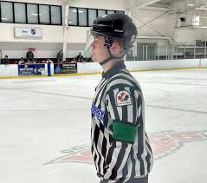
Green Arm Band
Officials <18 yo
Coach assessed GM automatic 2 game suspension (minimum)
Officials learn through
Supervisions
Learning from Peers
Development Sessions
BUT mostly OTJ Experience

Slide 63
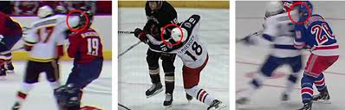
Points of View
Depending on where the official is positioned, players obstructing their view, or a “sneaky” player …. Officials may not observe the incident the same as others
Officials have to make decisions in a matter of micro-seconds

Slide 64
Count the F’s
Finished files are the result of years of scientific study
combined with the experience
of years of counting flies

Slide 65
Have a Great Season!
It is ok to disagree BUT do it in a respectful way
We don’t expect you will agree with ALL of our calls, but respect them
Officials DO NOT have to come to the bench to explain calls … Officials are trying to get games completed within the running time
Have FUN … it is a long season
If you have comments or questions regarding CPMHA officiating, please do not hesitate to contact me:
Ray Cronkwright
ref.chief@cpmha.ca

Slide 66
RISK & SAFETY
Suspensions
  Speak to you players about them. What are their thoughts, have they learned? If not discuss your side. Our goal is to reduce suspensions.
Hearings
  Prepare your player for hearings, ensure they understand the process and have remorse for their actions.
  Make sure parents and players know what to expect during the hearing
Remaining suspension will be sent to Convenors

Slide 67
RISK & SAFETY
Progressive Discipline – CPMHA Handbook
  The guideline prioritizes positive reinforcement but includes a progressive discipline
structure when necessary.
  Discipline is dealt with individually and can carry over from one season to the next.
  The document covers offenses related to both players and team officials (coaches and executive)
  The progressive discipline approach is a guideline only. CPMHA reserves the right to
increase or decrease consequences based on the severity of the offence.

Slide 68
RISK & SAFETY
Type 1 Offense (Minor Transgressions)
Examples: Messing up the dressing room, inappropriate language, disrespectful behavior, poor sportsmanship, excessive horseplay, hindering participation etc.
Consequences:
  First offense: Spoken to (two team officials) & documented, parent/guardian informed.
  Second offense: One period or practice time removal, consultation with level Convenor and Risk and Safety Director.
  Third offense: Multiple periods/game missed, internal hearing with Convenor, and Risk and Safety Director.
  Fourth offense: Dismissal from ice, internal hearing with Convenor, President, Vice President, and Risk and Safety Director.

Slide 69
RISK & SAFETY
Type 2 Offense (Major Transgressions)
  Examples: Fighting, insubordination, etc.
  Consequences:
    First offense: Dismissal from ice, player will sit for one period during game time, consultation with Convenor, Risk and Safety and parents.
    Second offense: Dismissal from ice, player will sit for multiple periods/game, internal hearing with Convenor and Safety Director.
    Third offense: Dismissal from ice, internal hearing with Convenor, President, Vice President, and Risk and Safety Director.
    Fourth offense: Removal from the association.

Slide 70
RISK & SAFETY
Type 3 Offense (Serious Offenses)
  Drugs/Alcohol:
    First offense: Dismissal from ice, 1-month suspension, meeting with Convenor, President, Vice President, and Risk and Safety Director.
    Second offense: Dismissal from ice, 1-year suspension, internal hearing with Risk and Safety Director.
    Third offense: Permanent ban from CPMHA.
  Theft:
    First offense: Dismissal from ice, 1-month suspension, meeting with Convenor, President, Vice President, and Risk and Safety Director.
    Second offense: Dismissal from ice, 1-year suspension, internal hearing with Risk and Safety Director.
    Third offense: Permanent ban from CPMHA. Reinstatement requires reimbursement of stolen items and a personal apology.

Slide 71
RISK & SAFETY
Type 3 Offense (Serious Offenses)
  Vandalism:
    First offense: Dismissal from ice, 1-month suspension, meeting with Convenor, President, Vice President, and Risk and Safety Director.
    Second offense: Dismissal from ice, 1-year suspension, internal hearing with Risk and Safety Director.
    Third offense: Permanent ban from CPMHA.
  Abuse, Bullying, and Harassment:
    Incident reports will be filed with HEO. Sanctions will be determined by HEO, considering the severity of the offense and any past discipline.
    Progressive discipline is not mandatory in cases of abuse, bullying, or harassment; a single offense can lead to significant sanctions.
Additional Notes:
• Any damage caused by players, coaches, officials, or parents (including vandalism or theft) will result in the recovery of costs from the responsible party.
• Outstanding amounts could lead to non-acceptance as a member for the following season.

Slide 72
Questions

